Slide 1



KemanaKita
Jelajah Keindahan Indonesia
Check our GitHub for more
https://github.com/perfect-less/KemanaKita.git
C22-PS052

Slide 2
"We will accompany you to the end of the heavens! Just tell us your destination in KemanaKita!."
KemanaKita
Notes:
kukuh

Slide 3
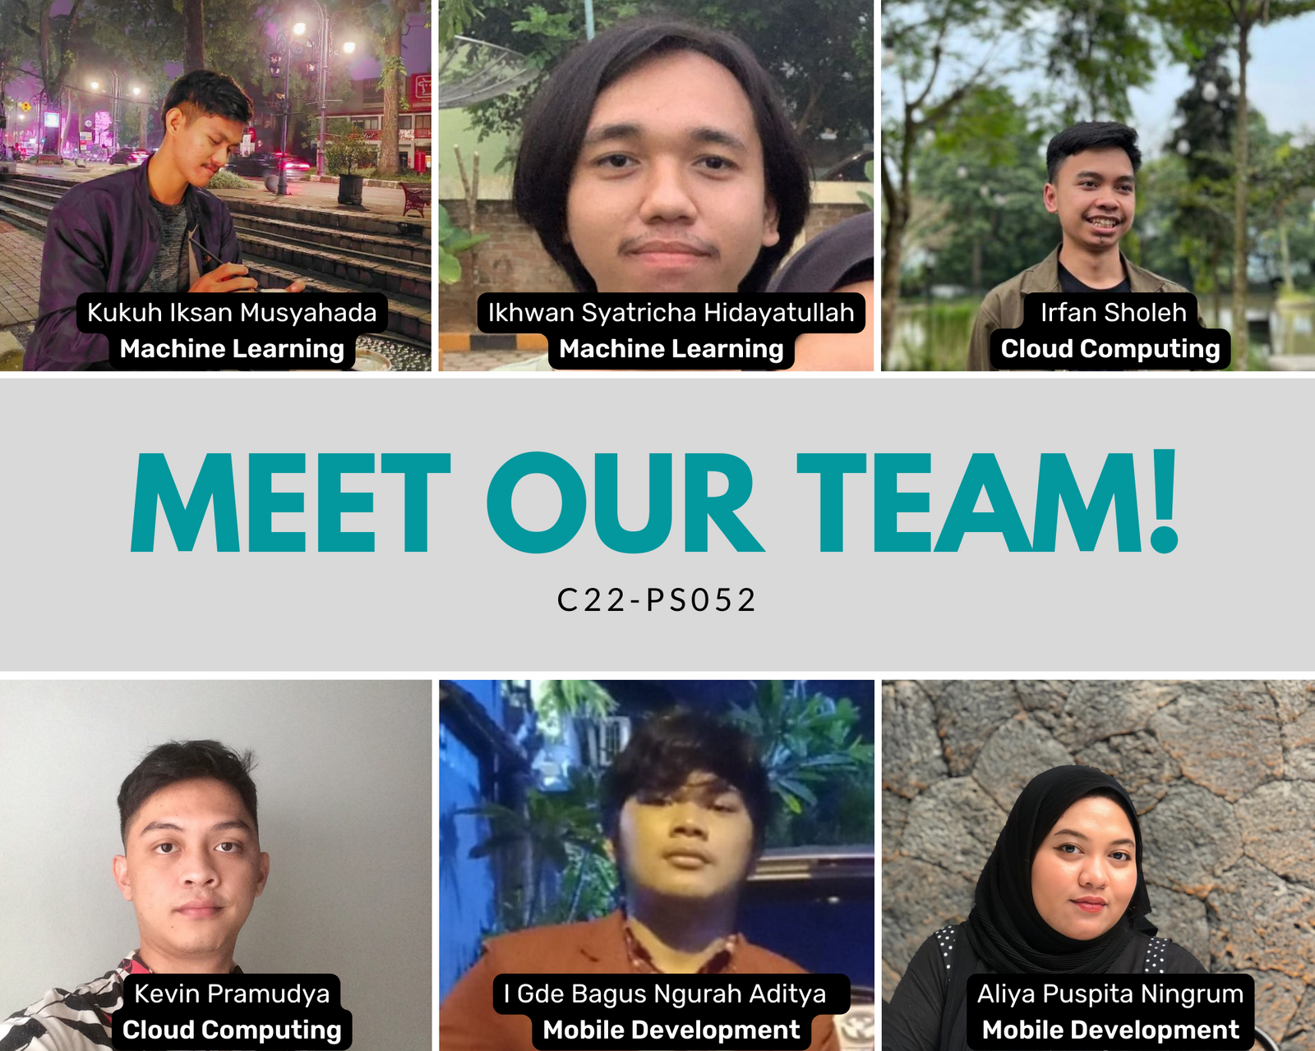

Notes:
kukuh

Slide 4
KemanaKita
We tried to make exploring and traveling the heavens in Indonesia much more fun and enjoyable. We aim to give you the best tour guide in your phone!
Notes:
kukuh

Slide 5
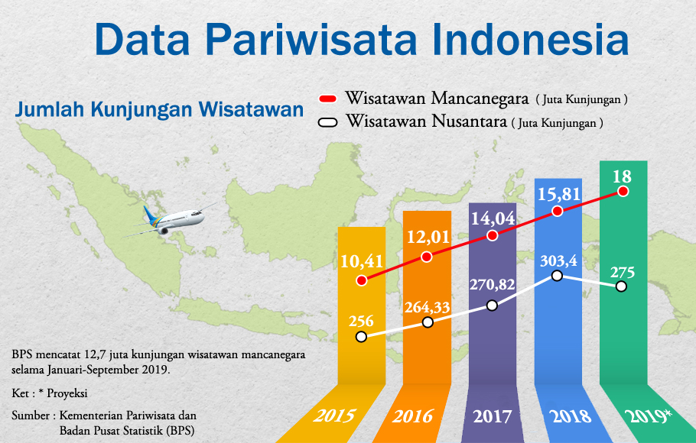
Background
https://www.beritasatu.com/fokus/pemerintah-genjot-industri-pariwisata
Notes:
kevin

Slide 6
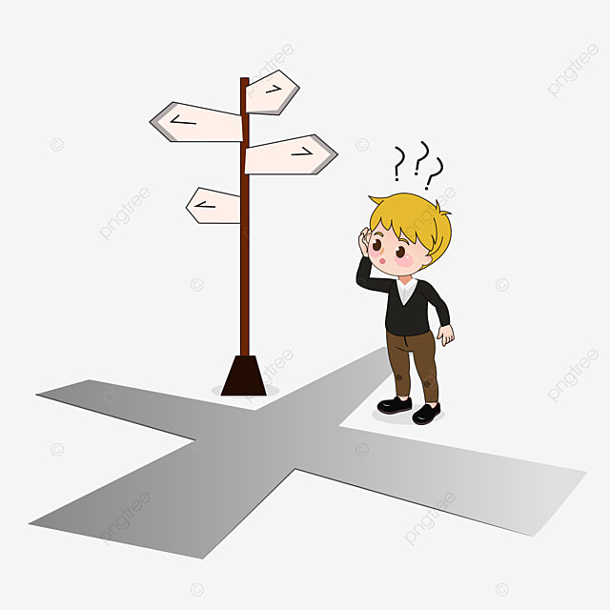
"Duh,kemana ya enaknya?!"
"Ah aplikasinya bikin binggung deh!"
"Tadi nama tempatnya apa ya?"

Slide 7
Why KemanaKita?
KemanaKita is a tour guide app that can accompany tourists during their tour and improve their experience, increasing interest in our tourism industry, and also making traveling easier for everyone. This application will be able to show the nearest tourist destinations and be able to provide an explanation of these attractions.
Notes:
bahar

Slide 8

Target Market or Personas
Age Range 20 - 35
People who have hobbies in
eksploring and travelling
Notes:
ikhwan

Slide 9
Our Final Goals!
1. All tourism destinations in Indonesia.
2. All user can be able to login.
3. All tourist can order ticket.
4. Able recommend nearest destination.
5. Show nearest route to destination.
6. And more.
Notes:
ikhwan

Slide 10
Build the initial application with initial models consist of 3 places in Bandung. In first feature, the application will be able to scan the 3 places in bandung and show the basic information about the places.
Notes:
ikhwan

Slide 11
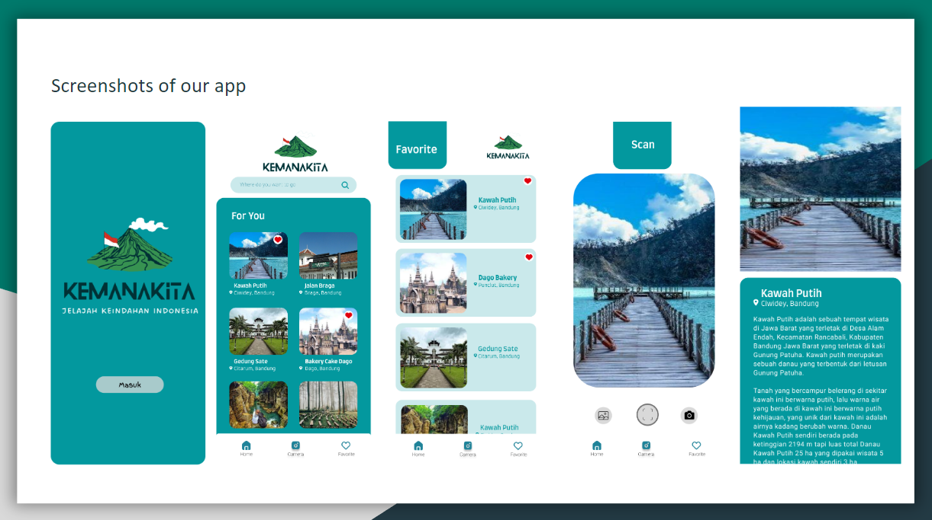

KemanaKita
UI!
Notes:
alin

Slide 12
KemanaKita App
Demo
Notes:
alin

Slide 13

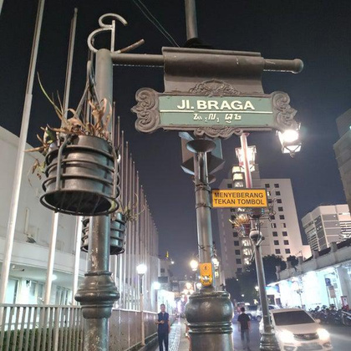
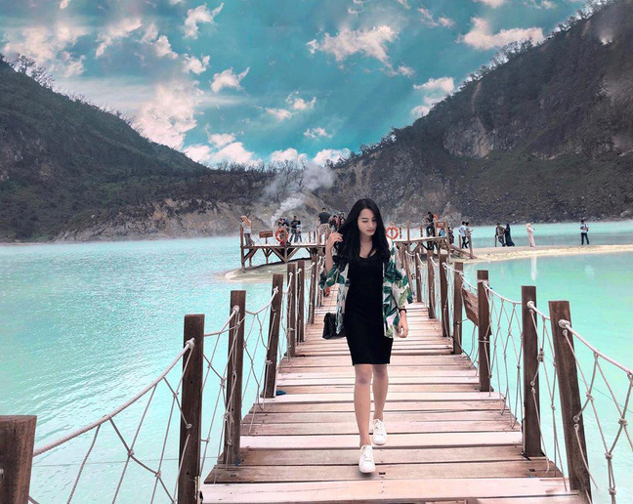
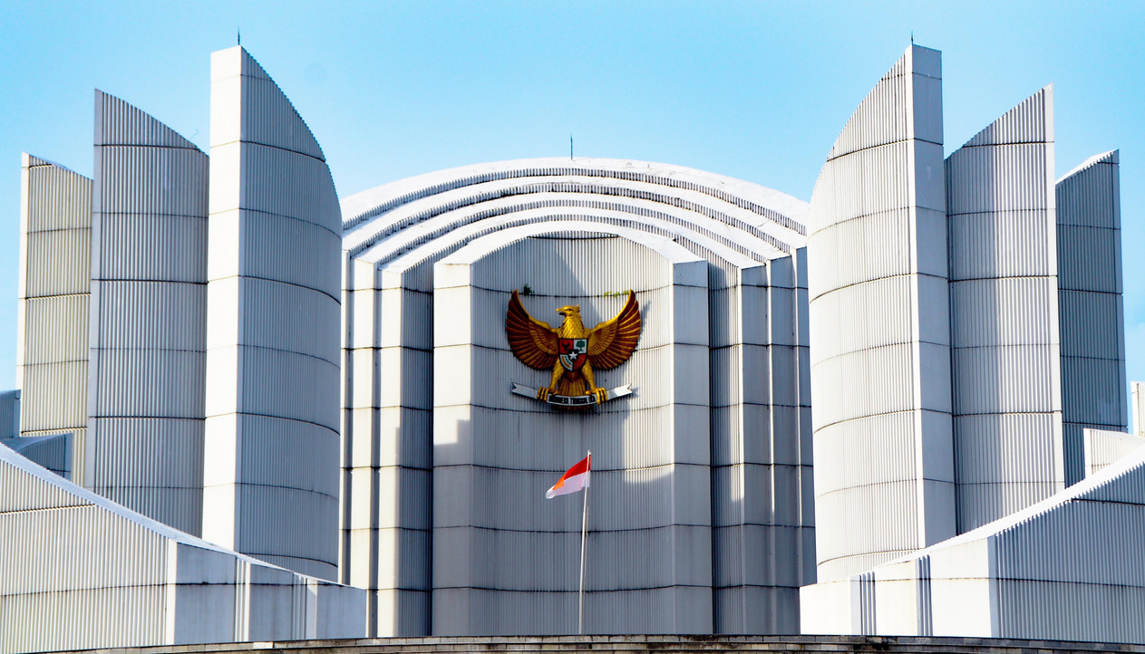
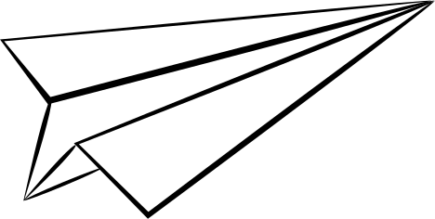
ML
Dataset
Model
Transfer Learning
Mobile Net V2
Input : image(224,224)
Output : 3 label
Total Params : 2,261,827
Trainable Params : 3,843
Training Time : 100 s
Obtain by Scraping
from
Google Image
Notes:
ikhwan

Slide 14
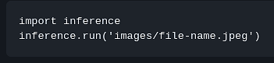
ML
ML
Result
Deployment
Directory Structure of Inference Module:
inference/
├── converted_model.tflite
├── images
│ ├── bragabandung0.jpeg
│ ├── kawahputihciwideybandung1.jpeg
│ └── monumenperjuanganbandung2.jpeg
└── inference.py
Notes:
ikhwan

Slide 15

CC

Slide 16

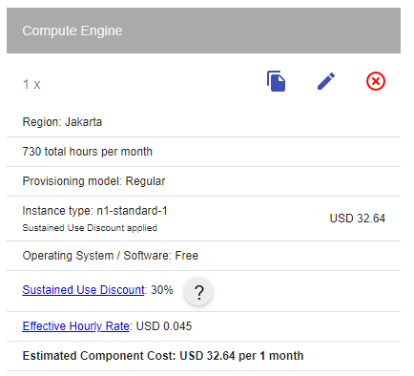



Cloud Computing
GCP Product & Price
The product that we used in Google Cloud Platform is:
Compute Engine
Notes:
kevin

Slide 17

Firebase
Store and Get Data
For get and store data we use non-relational database with realtime database Firebase.
Notes:
irfan

Slide 18

Designing & Testing API
Between ML Model and Mobile App
We're using Flask to deploy a machine learning model
Flask
Testing API endpoints using postman
Notes:
irfan

Slide 19





Flow Machine Learning & API
Compute Engine
User
Database
Machine Learning
Notes:
irfan

Slide 20

Documentation
For Extensive Documentation of our app, please refer to README of our Repo:
https://github.com/perfect-less/KemanaKita
Learning path specific documentation:
MD: https://github.com/perfect-less/KemanaKita/tree/main/android
CC: https://github.com/perfect-less/KemanaKita/tree/main/cc
ML: https://github.com/perfect-less/KemanaKita/tree/main/ml
Notes:
bahar

Slide 21

Thank You
Notes:
bahar

